Slide 1

Complex Decisions: Sequential Interactions

Slide 2
Unknown Environments
So far we have assumed full knowledge
Transition functions
Reward functions
What if we don’t have a complete model, but just get to interact with the world and learn through experience?

Slide 3
Monte Carlo methods
don’t need full knowledge of environment
just experience, or
simulated experience
averaging sample returns
defined only for episodic tasks
but similar to DP
policy evaluation, policy improvement

Slide 4
Monte Carlo policy evaluation
want to estimate V^{π}(s)
= expected return starting from s and following π
estimate as average of observed returns in state s
first-visit MC
average returns following the first visit to state s
s
s
s₀
R₁(s) = +2
+1
-2
0
+1
-3
+5
s₀
s₀
R₂(s) = +1
s₀
R₃(s) = -5
s₀
s₀
R₄(s) = +4
V^{π}(s) ≈ (2 + 1 – 5 + 4)/4 = 0.5

Slide 5
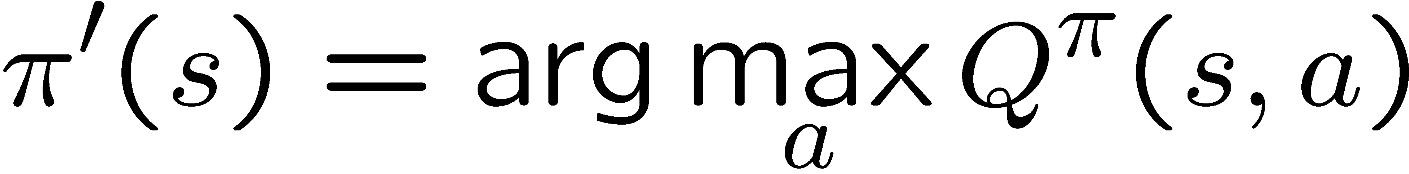


Monte Carlo control
V^{π} not enough for policy improvement
need exact model of environment
estimate Q^{π}(s,a)
MC control
Update rule after each episode
a problem
greedy policy won’t explore all actions

Slide 6
Maintaining exploration
key ingredient of RL
deterministic/greedy policy won’t explore all actions
don’t know anything about the environment at the beginning
need to try all actions to find the optimal one
maintain exploration
use soft policies instead: π(s,a)>0 (for all s,a)
ε-greedy policy
with probability 1-ε perform the optimal/greedy action
with probability ε perform a random action
will keep exploring the environment
slowly move it towards greedy policy: ε -> 0

Slide 7
Summary of Monte Carlo
don’t need model of environment
averaging of sample returns
only for episodic tasks
learn from:
sample episodes
simulated experience
can concentrate on “important” states
don’t need a full sweep
no bootstrapping
need to maintain exploration
use soft policies

